Slide 1

Group Victory
AIRBNB
Price Prediction
CIS 9650 Project
By Hailin Du
Qianwen Qian
Yan Wang
Janet (Trang) Le
Zibo Xu
Songchen Nan
01

Slide 2
02
Problem Statement
PROJECT OVERVIEW
There are currently no free and accurate services which help hosts price their properties using a wide range of data points.
Project Purpose
This project aims to help hosts determine a proper nightly rate based on the pricing model built from a range of relative factors in the New York Area.
KEY TOPICS
Inside Airbnb: http://insideairbnb.com/get-the-data.html.
https://github.com/Janetle-hi/Airbnb-Price-Prediction

Slide 3
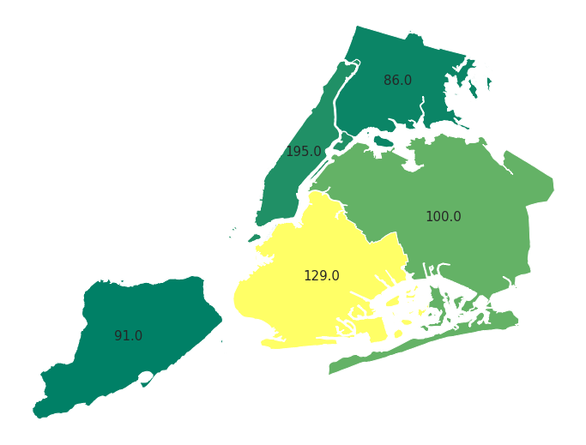
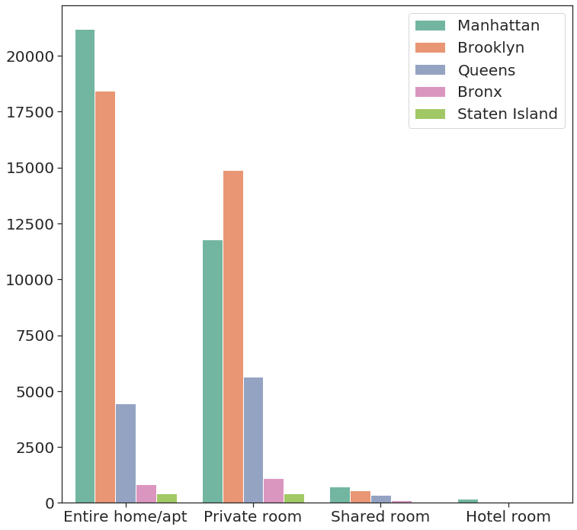
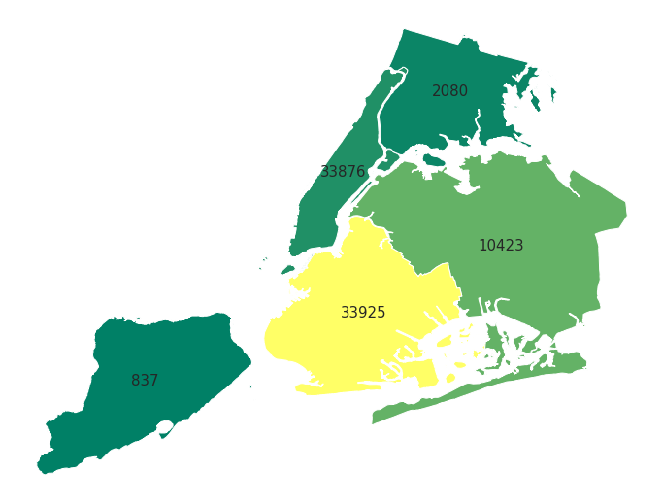
Exploratory Data Analysis
03
Average Price per Borough
Room types numbers per Borough
Total listings per Borough

Slide 4
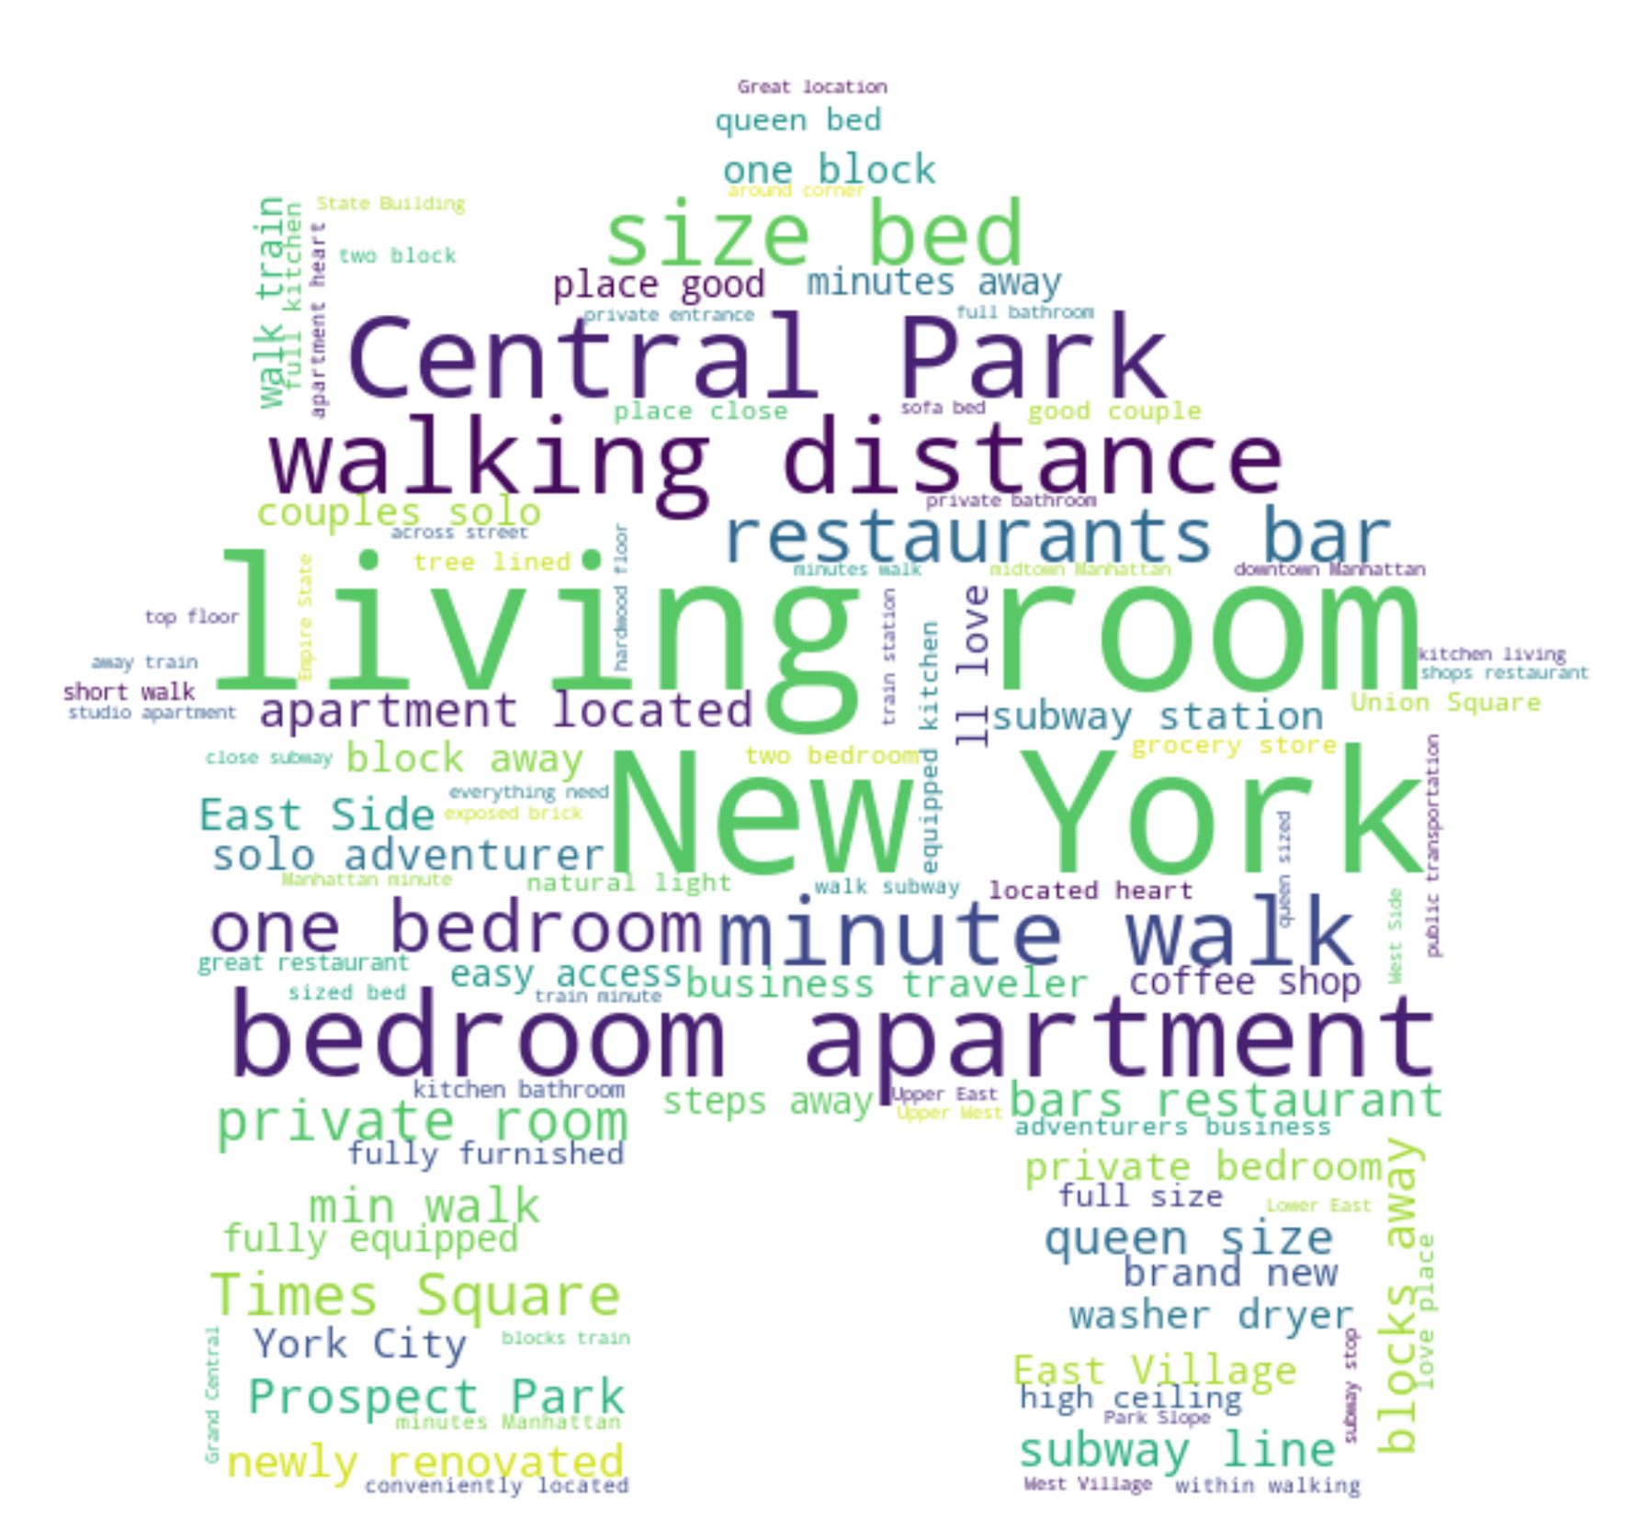
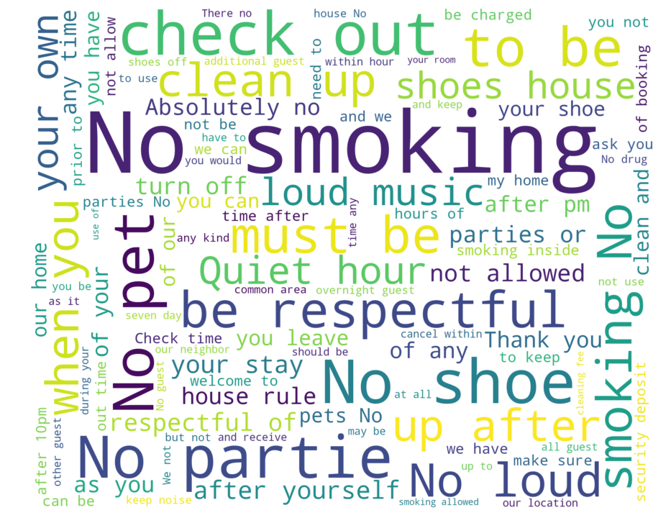
Wordcloud
04
Hosts’ Descriptions
House Rules

Slide 5
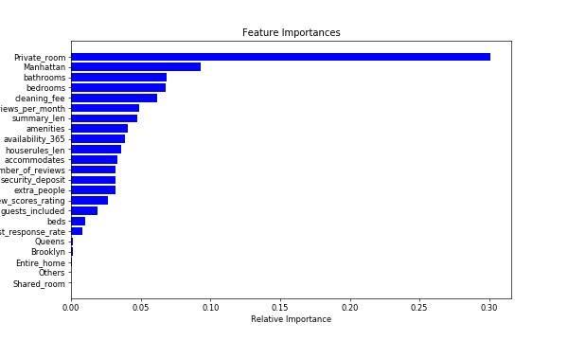
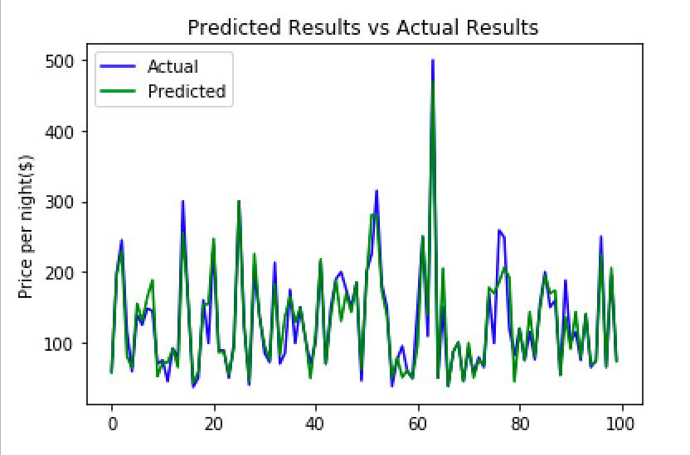
Price Model
05
Model: Random Forest Regression
Model Accuracy: 84.43%
Web: http://aec4.com/cis9650/airbnb.py
Notes:
https://www.airbnb.com/rooms/5681285?adults=3&check_in=2019-12-07&check_out=2019-12-09&source_impression_id=p3_1575739343_5p46wfEIyxNy46%2Fd

Slide 6
05
Questions?
Notes:
https://www.airbnb.com/rooms/5681285?adults=3&check_in=2019-12-07&check_out=2019-12-09&source_impression_id=p3_1575739343_5p46wfEIyxNy46%2Fd

